Slide 1
Joint Modeling of Local and Global Behavior Dynamics
for Session-based Recommendation
汇报人：Gu Tang
时间：2021.1.31
Conference：ECAI
Github: https://github.com/chenjh1988/LGSR.git.

Slide 2
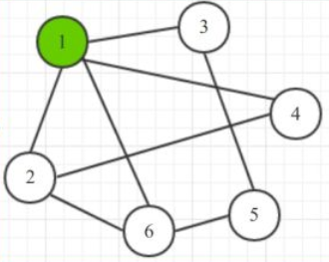
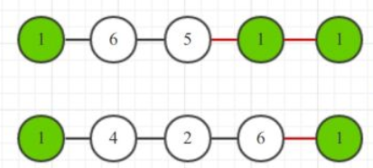
Motivations
While prior works have made efforts to addressing the session-based recommendation
problem, two significant limitations exist: i) They ignore the fact that items may be correlated with other across different session units; ii) existing solutions are also limited in their assumption of rigidly ordered pattern over intra-session item transition, which may not
be true in practice.
Random
walk

Slide 3
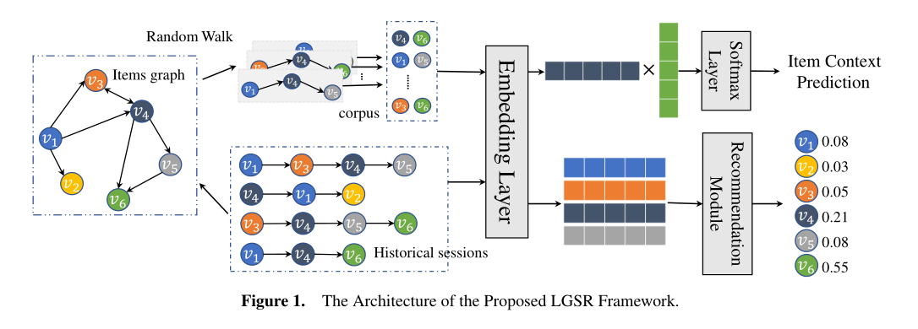
Model Architecture

Slide 4
Model Architecture

Slide 5
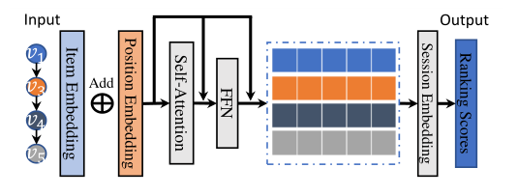
CoSan Prepare-data

Slide 6
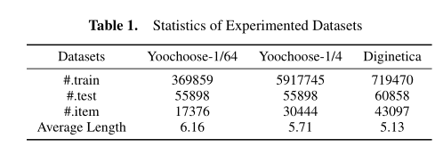
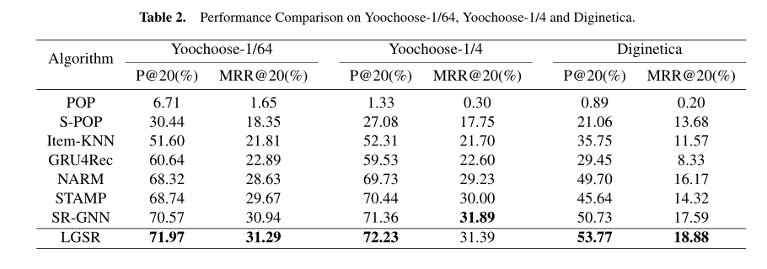
Experiment

Slide 7
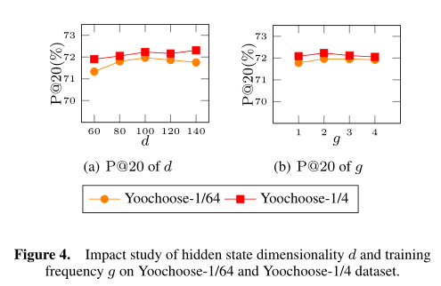
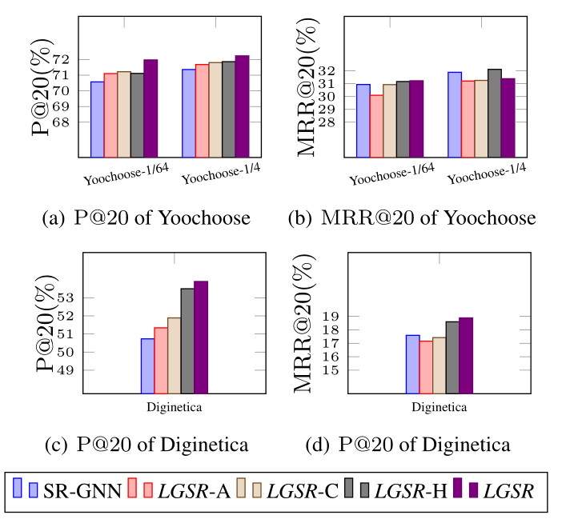
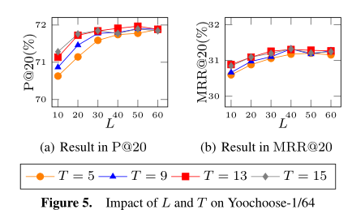
Experiment

Slide 8
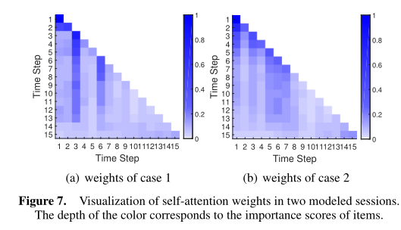
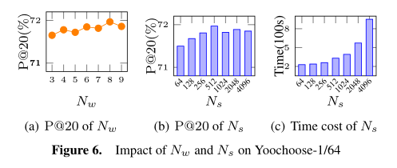
Experiment

Slide 9
THANGKS!

